Slide 1

Contents
S6-Optical Sources: Light source materials, LED Structures;
S7-LED Characteristics
S8- Semiconductor Laser Diode, LASER Characteristics

Slide 2
Light Source Materials
In direct bandgap semiconductor electrons and holes can recombine directly across bandgap without needing a third particle to conserve momentum
Radiative recombination sufficiently high to produce an adequate level of optical emission
Direct bandgap compounds are made from III-V materials
III element- Al, Ga, In
V element- P, As, Sb
Principal material used is the ternary alloy Ga_{1-x}Al_{x}As
The ratio ‘x’ of AlAs to GaAs determines the bandgap of the alloy and wavelength of the peak emitted radiation.
The value of x for the active area material- 800-850nm

Slide 3
Light Source Materials

Slide 4
Light Source Materials
For longer wavelengths – Quaternary alloy-> In_{1-x}Ga_{x}As_{y}P_{1-y}
Very close match between the crystal lattice parameters of the two adjoining heterojunctions is required to reduce interfacial defects and to minimize strains in the device as temperature varies
The fundamental quantum mechanical relationship between energy E and frequency v is given as
Wavelength in micrometers is given as

Slide 5
Light Source Materials
In the ternary alloy GaAlAs the bandgap energy E_{g} and the crystal lattice spacing a₀ are determined by dashed line as in figure
The energy bandgap for values of x from 0 to 0.37 is given as
For In_{1-x}Ga_{x}As_{y}P_{1-y} bandgap is given as

Slide 6
Light Source Materials
Typical Characteristics of surface and Edge emitting LEDs

Slide 7
Light Emitting Diode (LED)
Best light source for system requiring bit rates less than 100-200Mb/s and optical power in tens of microwatts
Less complex drive circuitry
No thermal or optical stabilization circuits needed
Fabrication cost is less
Requirement-> High radiance output
-> Fast emission response time
-> High quantum efficiency
Measure of optical power radiated in to a unit solid angle per unit area of emitting surface
Time delay between the application of a current pulse and the onset of optical emission
Fraction of injected electron hole pairs that recombine radiatively

Slide 8
LED Structures
To achieve a high radiance and a high quantum efficiency, LED structure should provide carrier confinement and optical confinement
Carrier confinement: used to achieve high level of radiative recombination in the active region of the device -> yields high quantum efficiency.
Optical confinement: prevents absorption of the emitted radiation by the material surrounding pn junction
Most effective LED structure to achieve these confinement is Double heterostructure or heterojunction (two different alloy layers on each side of active region)
This structure confines both carriers and optical field in central active layer

Slide 9
LED Structures
The bandgap differences of adjacent layers confine the charge carriers
Difference in the indices of refraction of adjoining layers confine the optical field to the central active layer
Dual confinement leads to both high efficiency and high radiance
Other parameters influencing the device performance
Optical absorption in active region
Carrier recombination at the heterostructure interface
Doping concentration of active layer
Injection carrier density
Active layer thickness
Two basic configurations
Surface Emitter
Edge Emitter

Slide 10
LED Structures
Cross sectional drawing of a typical GaAlAs double heterostructure light emitter
Energy band diagram showing the active region, electron and hole barriers that confine the charge carriers to the active layer
Variations in the refractive index

Slide 11
LED Structures- Surface Emitter

Slide 12
LED Structures- Surface Emitter
The plane of the active light emitting region is oriented perpendicularly to the axis of the fiber
The fiber is cemented in the well etched in the substrate to accept the emitted light
Circular active are is 50µm in diameter and 2.5µm in thickness
Emission pattern is essentially isotropic with 120° half power beam width
Isotropic pattern from surface emitter is called as lambertian pattern
Equal brightness from all sides, but power diminishes as cosθ
θ -> angle between the viewing direction and the normal to the surface

Slide 13
LED Structures- Edge Emitter
θ|| ≈ 120°
θ_{Ʇ} ≈ 30°

Slide 14
LED Structures- Edge Emitter
Active junction region is the source of the incoherent light and two guiding layers
Guiding layers both have a refractive index lower than that of active region but higher than index of surrounding material
Contact stripes for the edge emitter 50 – 70 µm wide and length of the active regions range from 100 to 150 µm
Emission pattern is more directional than surface emitter
In plane parallel to junction, the emitted beam is lambertian with a half power width of θ|| ≈ 120°
In the plane perpendicular to the junction, the half power θ_{Ʇ} is 25-35°

Slide 15
Quantum Efficiency and LED Power
Minority carriers are created by carrier injection at device contacts
When carrier injection stops, the carrier density returns to equilibrium
The excess carrier density decays exponentially with time as
n0- initial injected excess electron density
τ – Carrier life time.
Excess carriers recombine radiatively or non radiatively
Radiative recombination: photon of energy hγ is emitted
Non radiative recombination: It includes optical absorption in active region, carrier recombination at heterojunction and auger process (energy released during recombination is transferred to another carrier in the form of kinetic energy)

Slide 16
Quantum Efficiency and LED Power
Total rate of carrier generation = externally supplied rate + thermally generated rate
The rate equation for carrier recombination in an LED is given as
J/qd -> externally supplied rate
n/τ -> thermal generation rate
The equilibrium condition is given by setting equ (1) to zero. Thus
………………….. (1)
………………….. (2)

Slide 17
Quantum Efficiency and LED Power
The internal quantum efficiency in the active region is the fraction of electron hole pairs that recombine radiatively
It is the ration of radiative recombination to total recombination
R_{r}-> Radiative recombination
R_{nr}-> Non Radiative recombination
Radiative lifetime is
Non radiative lifetime is
Internal quantum efficiency is given as
………………….. (3)
………… (4)

Slide 18
Quantum Efficiency and LED Power
Bulk recombination lifetime is given as
R_{r} and R_{nr} is similar in magnitude, so the internal quantum efficiency is 50% for simple homojunction LEDs
Heterojunction-> 60-80%
Total number of recombination per second is
Sub (6) in (3) --->
Optical power generated is
………………….. (5)
…………(6)
……..………(7)

Slide 19
Quantum Efficiency and LED Power
Emitted power-> need to consider external quantum efficiency
It is defined as ratio of the photons emitted from the LED to the number of internally generated photons
It is given as
T(φ) - > Fresnel transmissivity or Fresnel transmission coefficient and depends on incidence angle φ
……..………(8)
……..………(9)

Slide 20
Quantum Efficiency and LED Power
When n1 = n, then and external quantum efiiciency is given as
The optical power emitted from LED is
……..………(10)
……..………(11)

Slide 21
LED Characteristics
SLED radiates significantly more optical power
SLED and ELED are linear at moderate drive currents
SLED gives high output power for more forward current
Low spectral width allows increased data rate.
η_{int} decreases with increasing temperature, thus light output decreases
ELED has high temp dependence than SLED

Slide 22
Numericals

Slide 23
Numericals

Slide 24
Numericals

Slide 25
LASER DIODE
LASER is an acronym for “Light Amplification by Stimulated Emission of Radiation”.
•Coherent light
•Narrow beam width
•Lasers can produce high output power. In fiber optic communication applications, semiconductor lasers power more than 20 milliwatts are available.
•As Laser light is Coherent, a high percentage (50% to 80%) can be coupled into the fiber core.

Slide 26
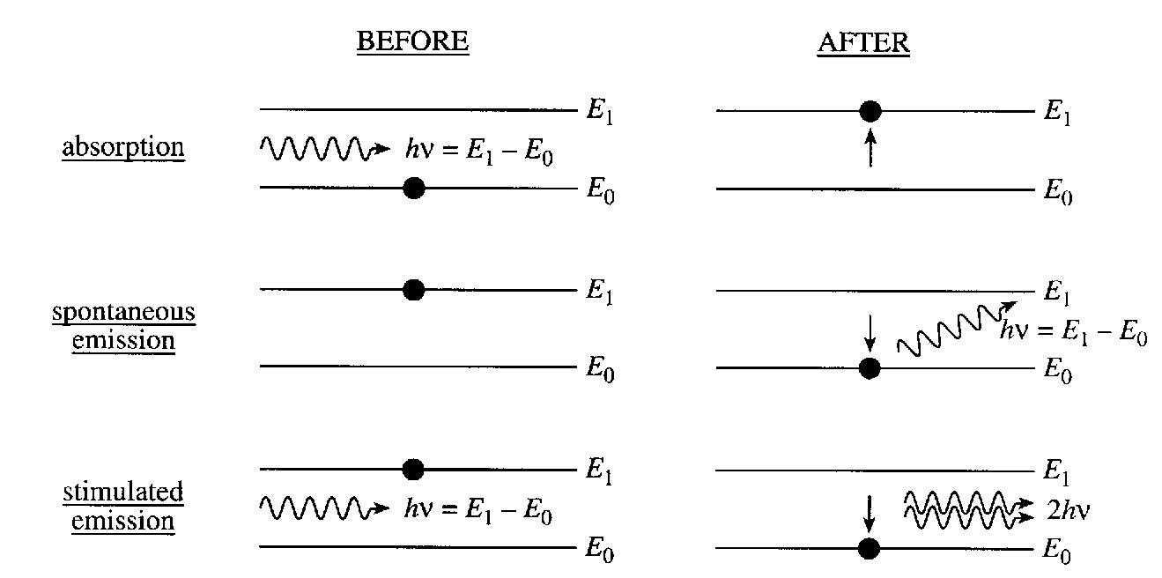
LASER : Basic Operation Fundamental Lasing Operation
Absorption
Spontaneous emission
Stimulated emission
Energy absorbed from the incoming photon
Random release of energy
Coherent release of energy

Slide 27
LASER : Basic Operation Fundamental Lasing Operation
At thermal equilibrium : Photon absorption and emission processes take place side by side, but because N1>N2 ; absorption dominates.
•Laser operation requires stimulated emission exclusively and to achieve this, majority of atoms should be at higher energy level than at lower level.
•Energy is to be supplied to the laser medium to raise atoms from the lower level to the excited level
•The process by which atoms are raised from the lower level to the upper level is called pumping.

Slide 28
LASER : Basic Operation Fundamental Lasing Operation
In Stimulated Emission incident and stimulated photons will have
•Identical energy → Identical wavelength → Narrow linewidth
• Narrow beam width
•Coherence and Identical polarization

Slide 29
CHARACTERISTIC OF LASER DIODE
Suitable for system Bandwidth >200 MHz
Response time less than 1 ns
Optical Bandwidth of 2 nm or less
Cable of coupling several tens of milliwatts of Luminescent Power
Can couple with optical fiber with small cores and small mode field diameters.

Slide 30
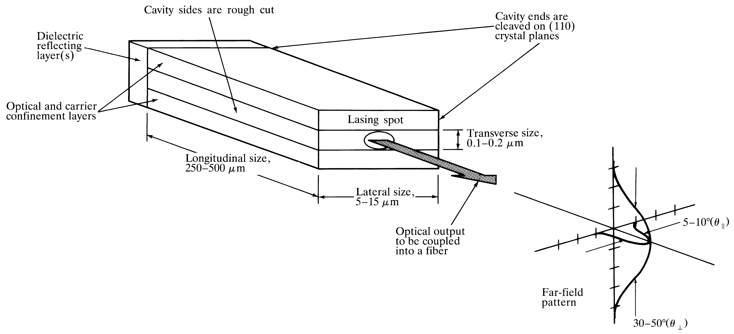
LASER DIODE
Laser diode is an improved LED, in the sense that uses stimulated emission in semiconductor from optical transitions between distribution energy states of the valence and conduction bands with optical resonator structure such as Fabry-Perot resonator with both optical and carrier confinements.
Optical Fiber communications, 3rd ed.,G.Keiser,McGrawHill, 2000

Slide 31
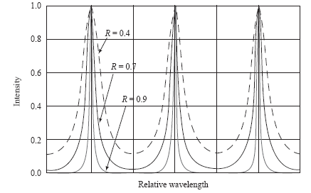
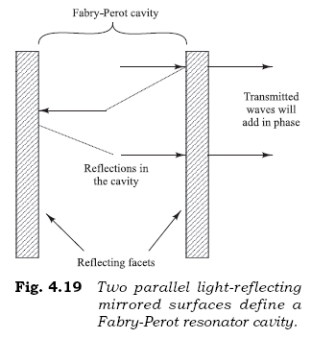
Fabry-Perot Lasing Cavity
A Fabry-Perot cavity consists of two flat, partially reflecting mirrors that establish a strong longitudinal optical oscillator feedback mechanism, thereby creating a light-emitting function.
The distance between the adjacent peaks of the resonant wavelengths in a Fabry-Perot cavity is the modal separation. If L is the distance between the reflecting mirrors & the refractive index is n, then at a peak wavelength λ the MS is given by

Slide 32
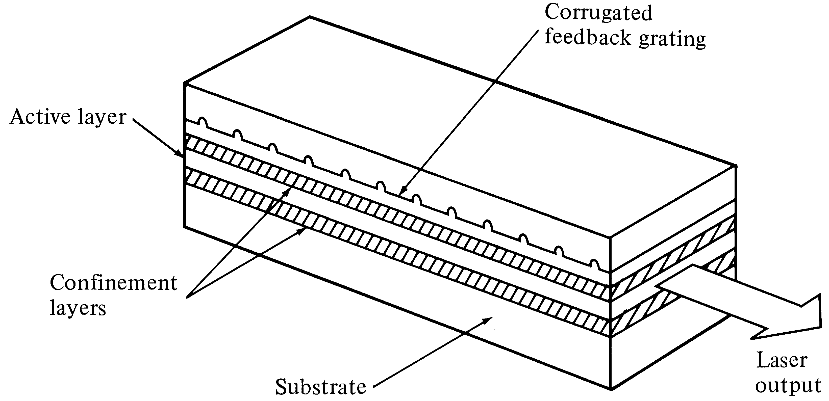
DFB(Distributed FeedBack) Lasers
In DFB lasers, the optical resonator structure is due to the incorporation of Bragg grating or periodic variations of the refractive index into multilayer structure along the length of the diode.
The optical feedback is provided by fiber Bragg Gratings
€ Only one wavelength get positive feedback
Optical Fiber communications, 3rd ed.,G.Keiser,McGrawHill, 2000

Slide 33

Laser Operation & Lasing Condition
To determine the lasing condition and resonant frequencies, we should focus on the optical wave propagation along the longitudinal direction, z-axis. The optical field intensity, I, can be written as:
Lasing is the condition at which light amplification becomes possible by virtue of population inversion. Then, stimulated emission rate into a given EM mode is proportional to the intensity of the optical radiation in that mode. In this case, the loss and gain of the optical field in the optical path determine the lasing condition.
The radiation intensity of a photon at energy varies exponentially with a distance z amplified by factor g, and attenuated by factor according to the following relationship:
$$hν$$

Slide 34
[4-20]
Z=0
Z=L
[4-21]
Lasing Conditions:
[4-22]

Slide 35
THRESHOLD GAIN & CURRENT DENSITY
LASER starts to Lase only if g>gth
For laser structure with strong carrier confinement, the threshold current
Density for stimulated emission can be well approximated by:

Slide 36
LASER RESONANT FREQUENCIES
Lasing condition, namely eq. [4-22]:
Assuming the resonant frequency of the mth mode is:

Slide 37
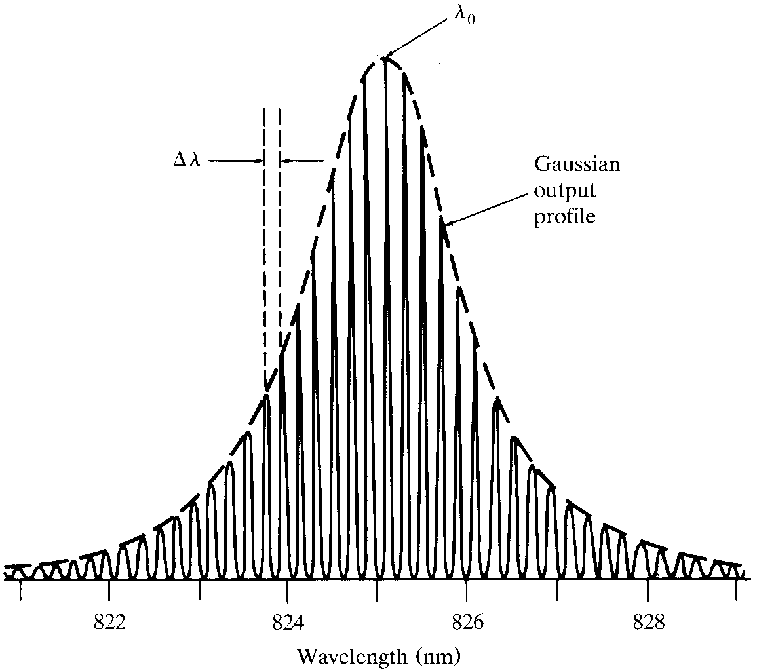
Spectrum from a Laser Diode

Slide 38
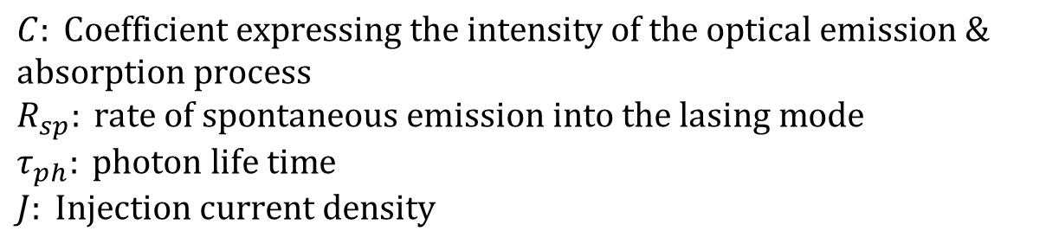
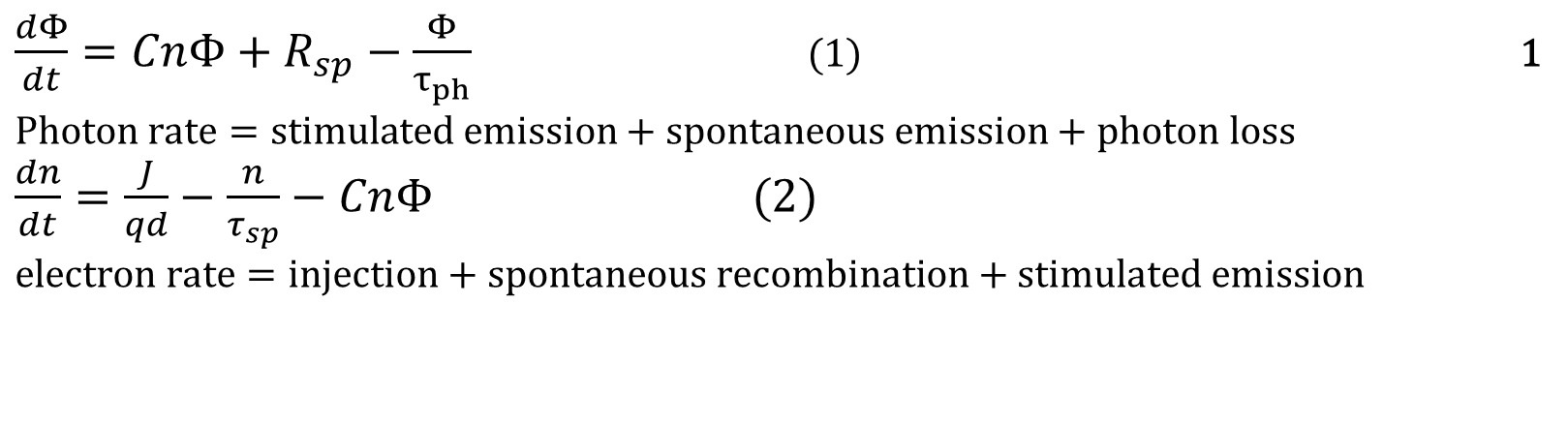
LASER RATE EQUATIONS
Rate equations relate the optical output power, or no of photons per unit volume, Φ , to the diode drive current or # of injected electrons per unit volume, n. For active (carrier confinement) region of depth d, the rate equations are:
$\frac{dΦ}{dt}=CnΦ+R_{sp}−\frac{Φ}{τ_{ph}}$ (1) 1 $$\text{Photon} \text{rate}=\text{stimulated} \text{emission}+\text{spontaneous} \text{emission}+\text{photon} \text{loss}$$ $\frac{dn}{dt}=\frac{J}{qd}−\frac{n}{τ_{sp}}−CnΦ (2)$ $$\text{electron} \text{rate}=\text{injection}+\text{spontaneous} \text{recombination}+\text{stimulated} \text{emission}$$
$$C: \text{Coefficient} \text{expressing} \text{the} \text{intensity} \text{of} \text{the} \text{optical} \text{emission}\text{ \& }\text{absorption} \text{process} \\ R_{sp}: \text{rate} \text{of} \text{spontaneous} \text{emission} \text{into} \text{the} \text{lasing} \text{mode} \\ τ_{ph}: \text{photon} \text{life} \text{time} \\ J: \text{Injection} \text{current} \text{density}$$

Slide 39
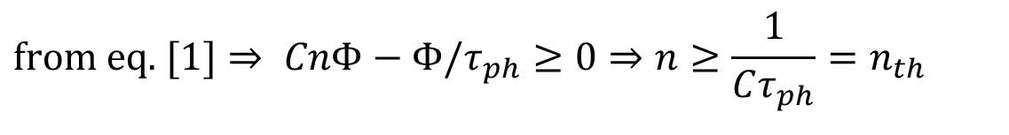
THRESHOLD CURRENT DENSITY & EXCESS ELECTRON DENSITY
At the threshold of lasing:
The threshold current needed to maintain a steady state threshold concentration of the excess electron, is found from electron rate equation under steady state condition dn/dt=0 when the laser is just about to lase:
$$\text{from} \text{eq}\text{. }[1]⇒ CnΦ−Φ/τ_{ph}≥0⇒n≥\frac{1}{Cτ_{ph}}=n_{th}$$

Slide 40
Laser operation beyond the threshold
The solution of the rate equations [4-25] gives the steady state photon density, resulting from stimulated emission and spontaneous emission as follows:

Slide 41
External quantum efficiency
Number of photons emitted per radiative electron-hole pair recombination above threshold, gives us the external quantum efficiency.
Note that:

Slide 42
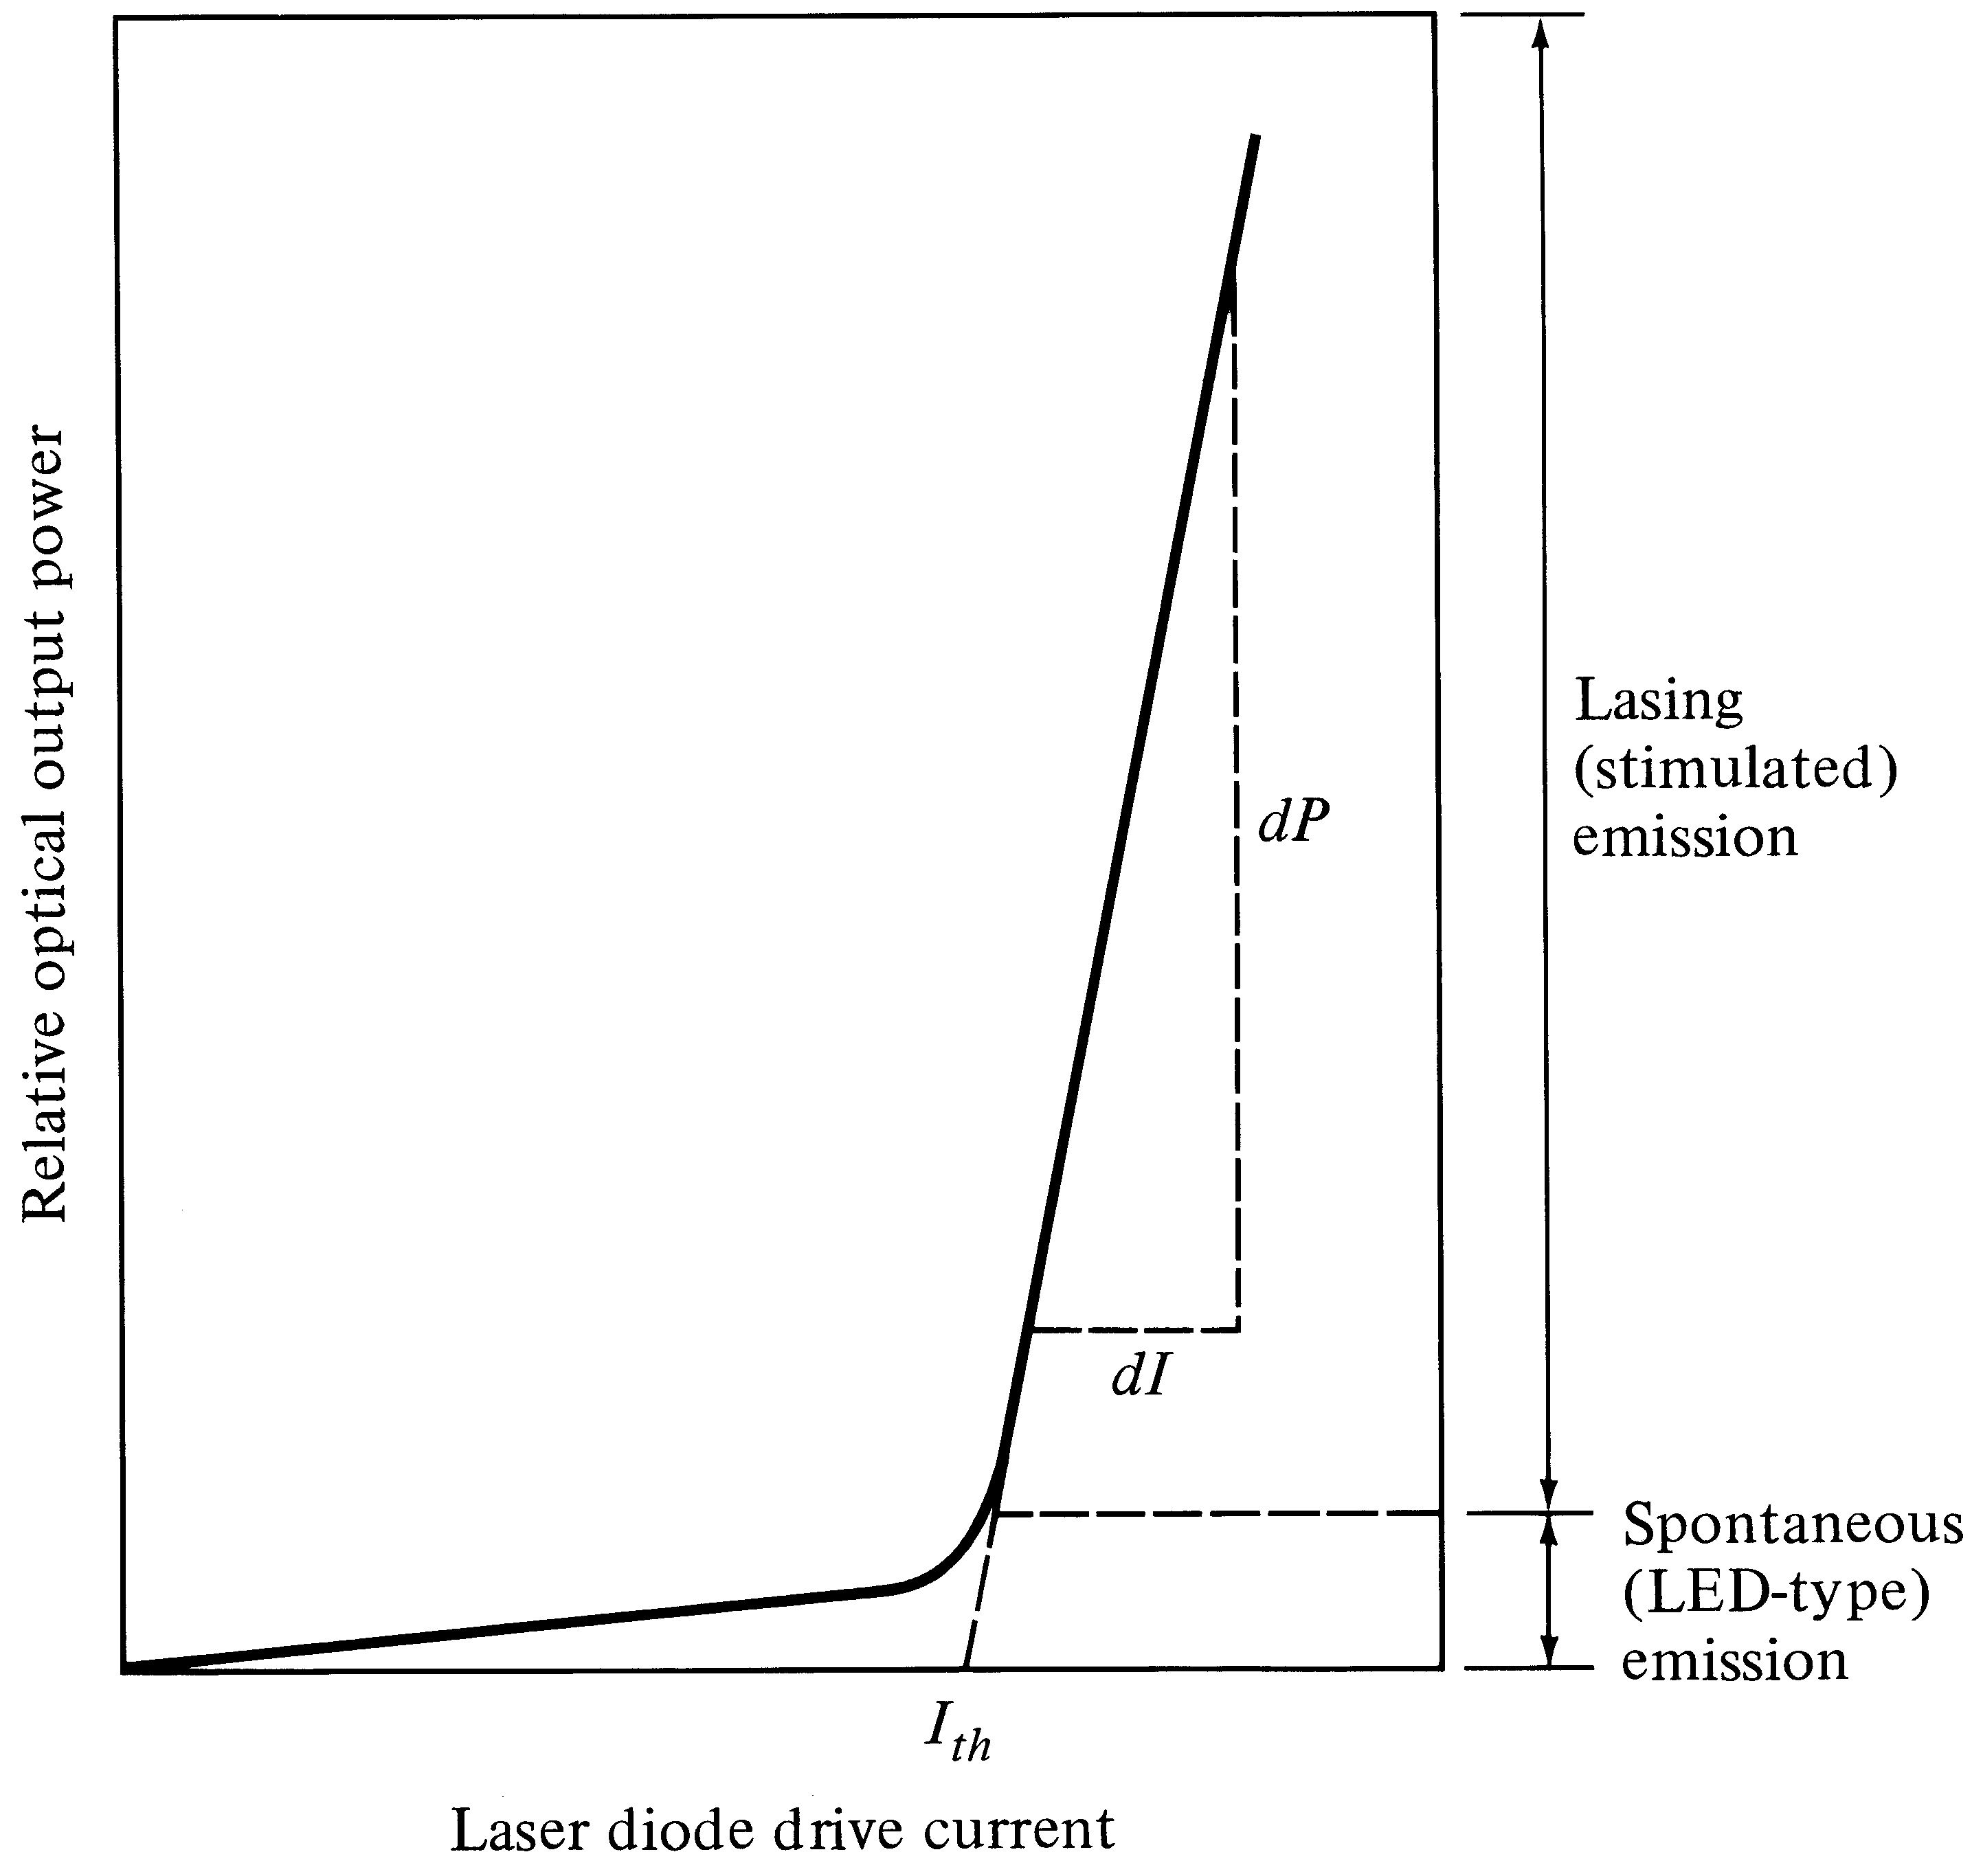
LASER P-I CHARACTERISTICS
External Efficiency
Depends on the slope
Threshold Current

Slide 43
Vertical Cavity Surface Emitting Laser- VCSEL
Vertical cavity means the structure (cavity) providing laser feedback is arrange in the vertical direction
Surface emitting means the laser beam is emitted perpendicular to the wafer
Semiconductor heterostructure forms an active region
Several quantum wells are made within this active region to enhance light gain
This region is placed between Bragg reflectors- the stacks of layers with alternate high and low refractive index material
Each layer is λ/4 thick and made from GaAs (n=3.6) and AlAs (n=2.9)
These layer work like high reflective mirror providing positive feedback

Slide 44
Vertical Cavity Surface Emitting Laser- VCSEL

Slide 45
Vertical Cavity Surface Emitting Laser- VCSEL
Advantages
Size of the resonant cavity is very small resulting in huge spacing between two adjacent longitudinal modes
Only one mode can be within gain curve
Operates in single mode regime
Very small dimensions (cavity and diameter of active region is about 1 to 5µm and thickness is 25nm)
Can fabricate many diodes on one substrate
Low power consumption and high switching speed
High current density at low current value
Short lifetime leading to high modulation bandwidth

Slide 46
Vertical Cavity Surface Emitting Laser- VCSEL
VCSEL diode radiates a circular output beam in contrast to that radiated by edge emitting lasers
Fabrication technology is very similar to that for electronic chips
Disadvantages
Commercially available in the wavelength range no longer than 850nm
Trend in VCSEL is to extend their operating wavelength to 1300nm and 1550nm

